Slide 1
Reading Together

Slide 2
Reading changes everything …
Teach a child to read and keep that child reading and we will change everything.
And I mean everything.
Jeanette Winterson
Stories … entertain and teach; they help us both enjoy life and endure it. After nourishment, shelter and companionship, stories are the things we need most in the world.
Philip Pullman
Notes:
Read quote.
Today I want to help you understand more about the Phonics Screening Check – a word reading test that all Year 1s undertake in June.
Accurate word-reading at six is a good predictor of future reading success.
In December 2018, research found that nearly 90% of children who passed the phonics check taken in Year 1 reached or exceeded the expected standard in reading in Year 6.

Slide 3
Proven power of reading …
2019 KS2 SATS: In reading, 73% of pupils reached the expected standard in 2019, down by 2 percentage points from 2018.
Students who read independently have greater reading comprehension, verbal fluency and general knowledge than those who do not. They become better readers, score higher on achievement tests in all subject areas, and have greater content knowledge than their non-reading peers. Research has consistently linked reading outside of school to improved academic performance.

Slide 4
Not just about test scores …
Reading for pleasure is more important for children's cognitive development than their parents' level of education and is a more powerful factor in life achievement than socio-economic background. (Sullivan and Brown 2013)
16-year-olds who choose to read books for pleasure outside of school are more likely to secure managerial or professional jobs in later life. (Taylor 2011)

Slide 5
Quantity is important
Best predictor for success at GCSE level is breadth of vocabulary at age 5.
5 minutes: 400, 000 words a year
21 minutes: 1,823,000 words a year
40 minutes: 3,646,000 words a year

Slide 6
What makes a good reader?
High frequency words
Story teller voice / rhythm
Sounding out
Practise
What is going on?
Notes:
We can’t integrate comprehension at the same time as decoding. Working memory only has a finite capacity. Imagine only reading a text one slow word at a time – could you then recall what you had just read. Fluency is crucial from day 1 of learning to read. A reading speed of 90 words per minute is needed for children to comprehend as a they read. Adults read approx. 150 words per minute. Teachers choose reading book bands carefully. If your child is reading a book that is too hard they will not develop fluency. Decoding is not the same as fluency. Rereading familiar texts is hugely beneficial

Slide 7
At School
Weekly reading whole class lesson which will focus on a particular skill
ERIC time
Theme books on display / text rich classroom environments
Class novel / English curriculum based on books
Individual reading / group reading
Reading is an integral part of our knowledge rich curriculum
Reading recovery / Fresh Start / RWI phonics boosters

Slide 8
At home …
Model reading
Read together as often as possible
Read when out and about eg. museum displays, road signs
Make book shelves inviting
Visit the library
Revisit books from your own childhood
Respect their reading choices
Read to your child high quality, vocabulary rich texts that are a level above their independent reading

Slide 9
Hearing your child read
By the end of year 2 your child may only need to read out loud as part of your time together
Encourage children to ‘read in their head’ and then tell you what has happened
Encourage independent use of vocabulary bookmark
Read regularly – it is very demoralising to be ‘stuck’ on the same book for a long time. This does not encourage reading for pleasure!
Can siblings be involved?

Slide 10
When they get stuck …
Phonics (sound out / fred talk)
Break the word into smaller chunks
Read by analogy – does it look like another word?
Picture clues (possibly)
Read around the word / finish the sentence and come back to it
Ask! Remember to check they understand the meaning of this new word.

Slide 11
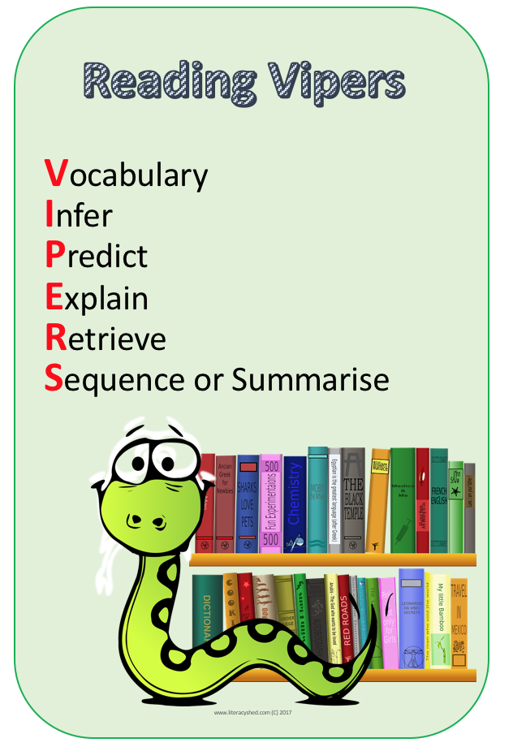
Quality questions …

Slide 12
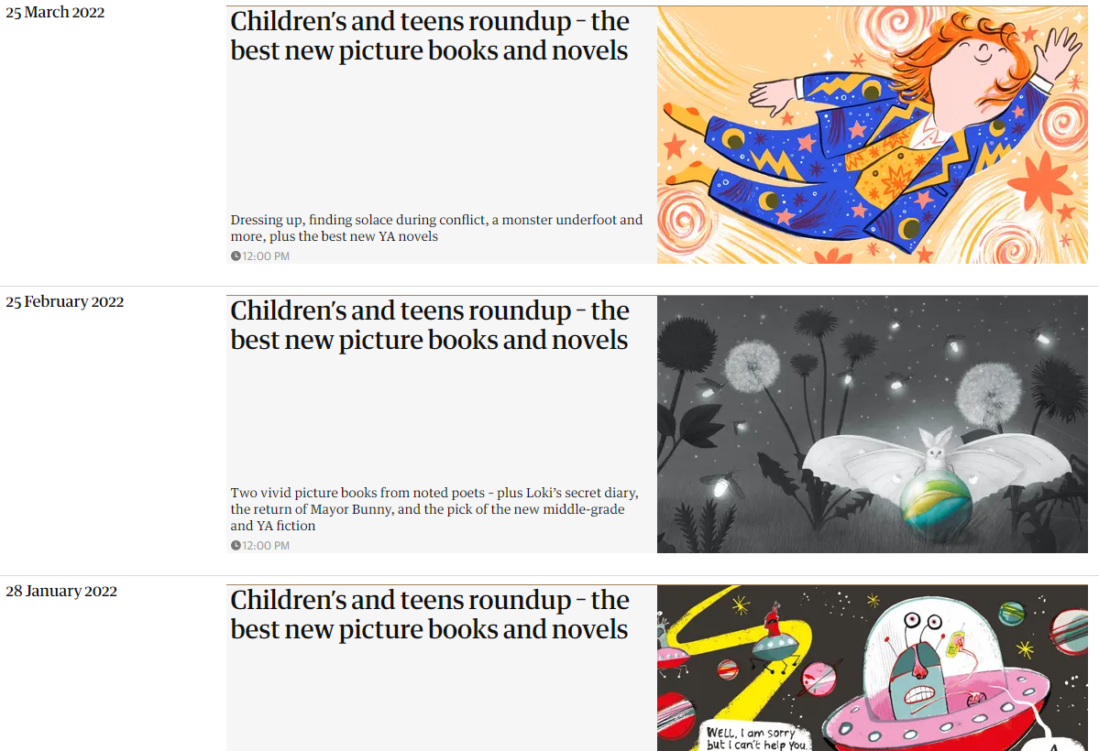
https://www.booksfortopics.com/
https://www.theguardian.com/books/series/children-s-book-roundup

Slide 13
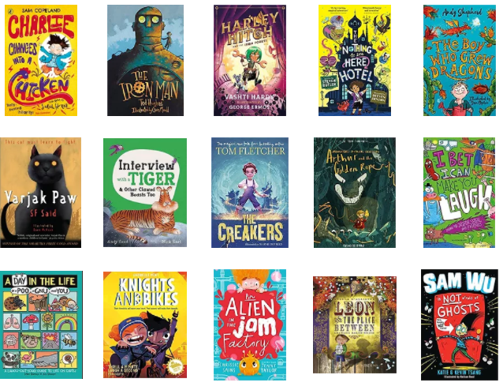
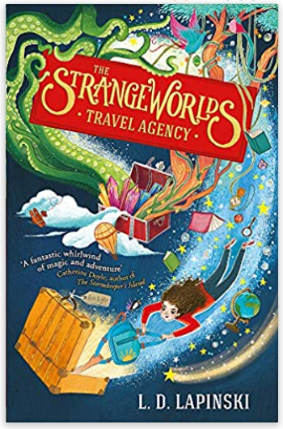
So many books to choose from …

Slide 14
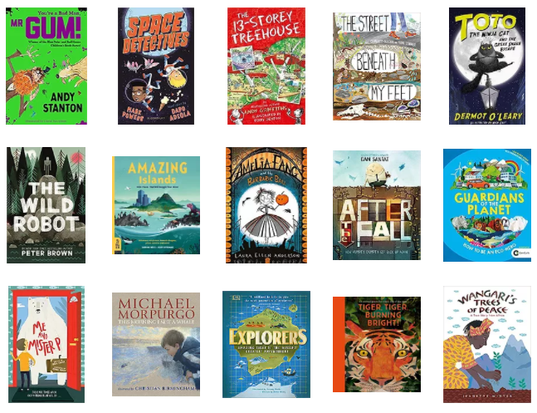
Suggested reading list

Slide 15
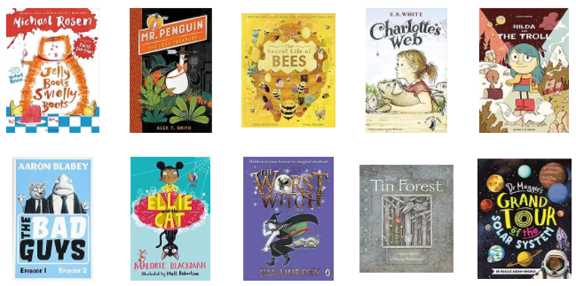
Suggested reading list

Slide 16
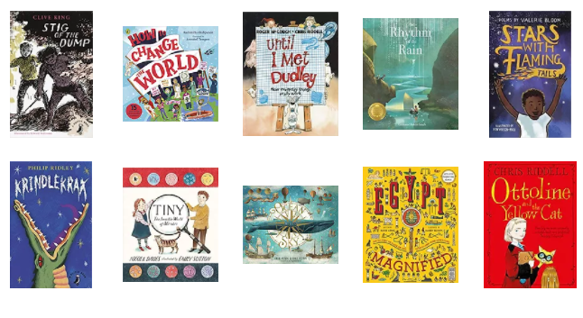
Suggested reading list

Slide 17
Read: Learn more.
Read. As much as possible. Mostly new stuff.
Reading expands one’s knowledge of language and the world in ways that increase reading skill, making it easier and more enjoyable to read.
Increases in reading skill make it easier to consume texts that feed this learning machinery.
This feedback loop is the mechanism that leads to expertise.
Mark Siedenberg: Language at the Speed of Sight (2018)

